Slide 1

Cycling Infrastructure Prioritisation Toolkit (CyIPT) / Active Transport Toolkit
from behaviour change targets (PCT) to infrastructure (CyIPT) Martin Lucas-Smith, CycleStreets.net, on behalf of the CyIPT team

Slide 2
Outline
Context
The Propensity to Cycle Tool
Tools to prioritise infrastucture

Slide 3

The scale of the challenge, from this…
Source: [Brent Toderian]

Slide 4

Towards cycling being the natural choice

Slide 5
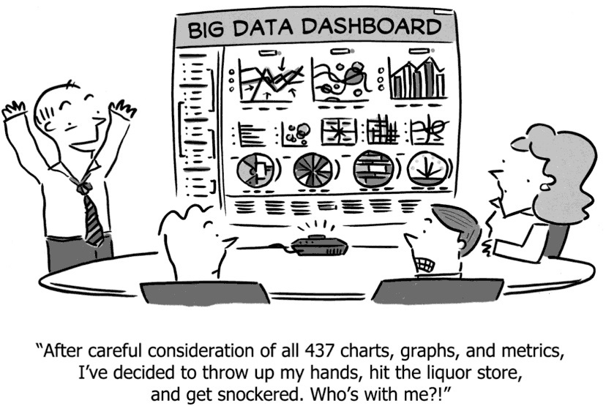
Problem: evidence overload
Problem is operationalising this data [@lovelace_propensity_2017]
Needs to be provided in a format that can be acted on at the local level

Slide 6

Context: the Propensity to Cycle Tool - see www.pct.bike
Included in Cycling and Walking Infrastructure Strategy (CWIS)

Slide 7
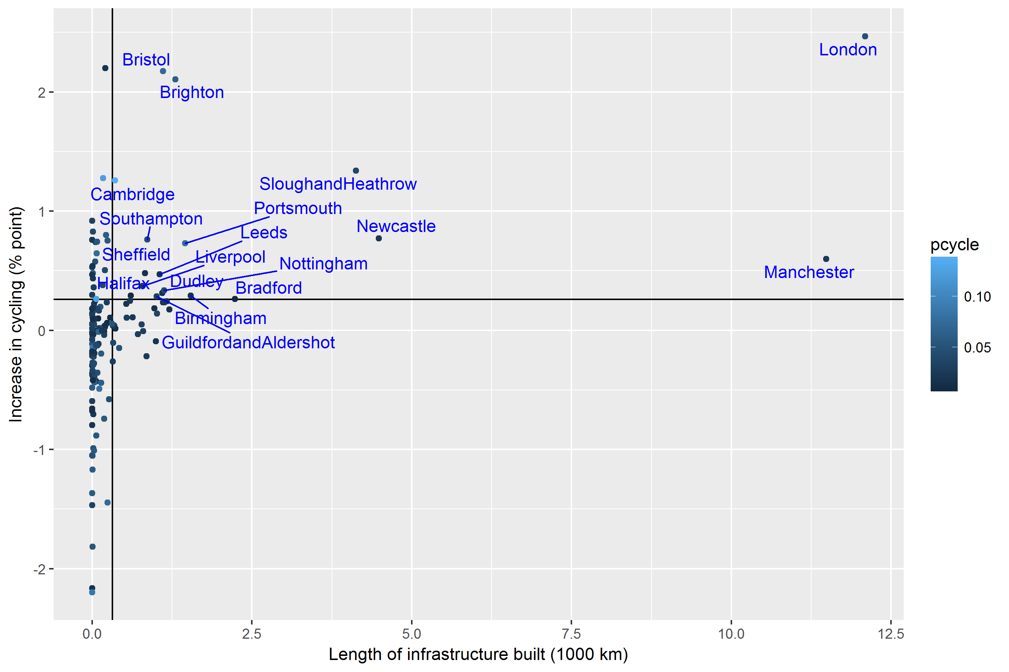
The importance of infrastructure
Clear link between infrastructure and uptake between 2001 and 2011

Slide 8
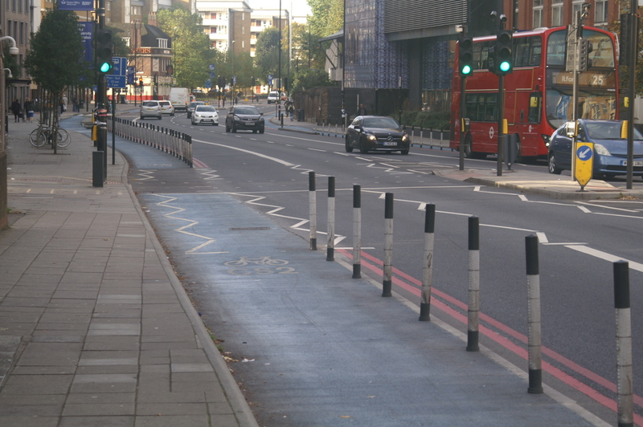
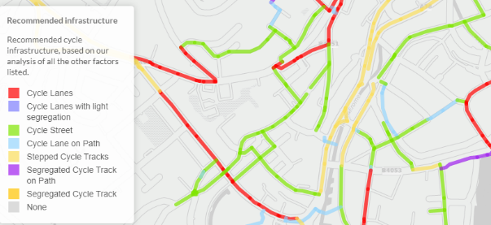
How to model infrastructure: CyIPT
Cycling Infrastructure Prioritisation Toolkit simulates cycle infrastructure schemes across the country
Interactive tool for planners: www.cyipt.bike (password protected)

Slide 9
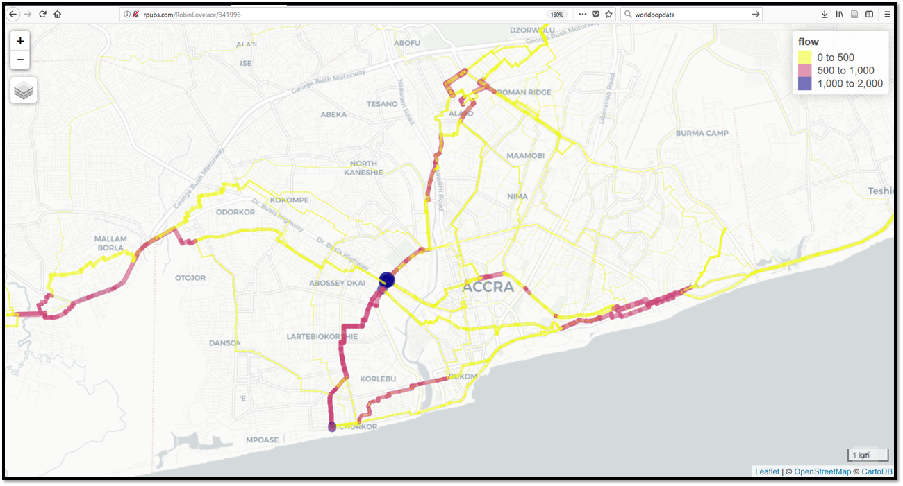
Active Transport Toolkit | source: github.com/ATFutures/who
World Health Organisation (WHO) funded project to explore cycling and walking

Slide 10
Demo of Active Transport Toolkit

Slide 11
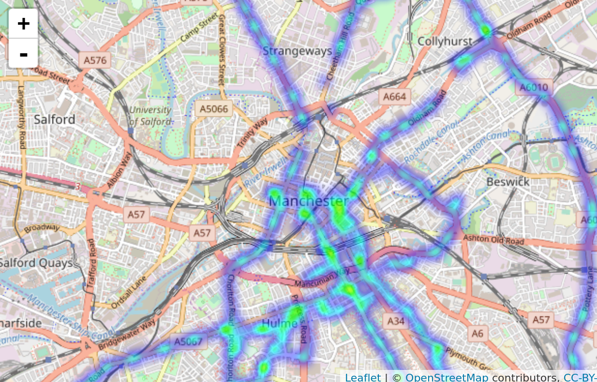
Next steps
Phase III PCT: Schools layer, training, ‘near market’ scenario
Phase II of CyIPT: research phase -> make publicly accessible
Evidence on impact of new infrastructure (PhD with CycleStreets.net)
Crowd-sourcing (passive): (See.Sense data shown below - topic of new PhD)
Integration of walking and cycling tools with sDNA [@cooper_testing_2018]

Slide 12
Links + references
Contact: info@cyipt.bike
The PCT in action: http://www.pct.bike/
A prototype of the CyIPT: http://cyipt.bike/

